Slide 1
Department of CSE
COURSE NAME: Data science
COURSE CODE: 24AD3107
Topic:
INTRODUCTION TO PYTHON AND NUMPY
Session – 7,8

Slide 2
AIM OF THE SESSION
To familiarize students with the basic concept of INTRODUCTION TO PYTHON AND NUMPY
INSTRUCTIONAL OBJECTIVES
This Session is designed to: Introduction about INTRODUCTION TO PYTHON AND NUMPY
LEARNING OUTCOMES
At the end of this session, you should be able to: basic knowledge about INTRODUCTION TO PYTHON AND NUMPY

Slide 3
INTRODUCTION TO PYTHON
Python is a very popular general-purpose interpreted, interactive, object-oriented, and high-level programming language. Python is a dynamically-typed and garbage-collected programming language. It was created by Guido van Rossum during 1985- 1990. Like Perl, Python source code is also available under the GNU General Public License (GPL).It was released in the year 1991.
Python is consistently rated as one of the world's most popular programming languages. Python is easy to learn, so if you are starting to learn any programming language then Python could be your great choice.
Python is Open Source which means its available free of cost.
Python is simple and so easy to learn
Python is versatile and can be used to create many different things.
Python has powerful development libraries include AI, ML, etc.
Python is much in demand and ensures high salary

Slide 4
INTRODUCTION TO PYTHON
Some of the important features of Python:
Python is open source: The Python implementation is under an open source license that makes it freely usable and distributable, even for commercial use.
Python is interpreted: Python is a high level language which is interpreted by a Python interpreter.
Python is cross platform compatible: Python can be executed on all major platforms like Windows, Linux/Unix, OS/2, Mac and others.
Python is Object-Oriented: In Python, we encapsulate data within the objects as it supports the object-oriented style of programming.
Python is a great choice for new learners: Python is easy to learn and follows a simple syntax, so it is a good choice for beginner programmers. Python also supports wide range of application development.
Python is extensible: Python has a wide range of libraries and built-in functions which helps in easy and rapid development of applications.
Python is interactive: Python users are provided a command prompt where they can interact directly with the interpreter to write programs.
Database connectivity: Python provides interfaces required to connect to all major databases like Oracle, MySQL, PostgreSQL and others.

Slide 5
HOW TO INSTALL PYTHON IN WINDOWS
Step 1 − Select Version of Python to Install
Step 2 − Download Python Executable Installer
On the web browser, on the official site of python (www.python.org), move to the Download for Windows section.
All the available versions of Python will be listed. Select the version required by you and click on Download. Let’s suppose, we chose the Python 3.9.1 version.
Step 3 − Run Executable Installer
We downloaded the Python 3.9.1 Windows 64-bit installer.
Run the installer. Make sure to select both the checkboxes at the bottom and then click Install New.
Step 4 − Verify Python is installed on Windows
To ensure that Python is successfully installed on your system. Follow the given steps −
Open the command prompt.
Type ‘python’ and press enter.
The version of the python which you have installed will be displayed if the python is successfully installed on your windows.

Slide 6
Knowledge on below concepts of any programming language will be useful.
Identifiers and keywords
Variables
Data types
Branching statements
Looping statements
Functions
Type conversion

Slide 7
Identifiers
In Python, variables, functions, classes, modules and objects are identified using a name known as an identifier. An identifier can start with an uppercase or lowercase character or an underscore (_) followed by any number of underscores, letters and digits. All identifiers in Python are case sensitive.
Example: weight=10
In the above example, weight is an identifier.
Keywords:
Keywords are the reserved words in Python. So keywords cannot be used as identifiers or to name variables and functions. Few of the keywords are listed below.
Example: if, else, elif, for, where, break, continue

Slide 8
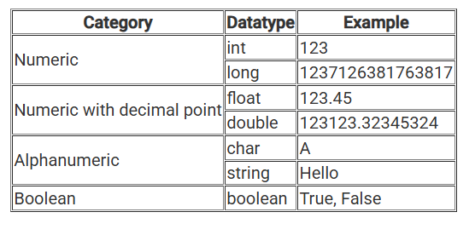
Variable:
Variables are containers for storing data values.
Creating a Variable:
Python has no command for declaring a variable.
A variable is created the moment you first assign a value to it.
x = 50
y = “KLH-BOWREMPET“
Z=5.5
Variables do not need to be declared with any particular type, and can even change type after they have been set

Slide 9
Variable Names:
A variable can have a short name (like x and y) or a more descriptive name (age, carname, total_volume).
Rules for Python variables:
A variable name must start with a letter or the underscore character
A variable name cannot start with a number
A variable name can only contain alpha-numeric characters and underscores (A-z,
0-9, and _ )
Variable names are case-sensitive (age, Age, and AGE are three different variables)
Example:
myvar = “KLH-BOWREMPET"
my_var = " KLH-BOWREMPET "
_my_var = " KLH-BOWREMPET "
myVar = " KLH-BOWREMPET "
MYVAR = " KLH-BOWREMPET "
myvar2 = " KLH-BOWREMPET "

Slide 10
Many Values to Multiple Variables:
Python allows you to assign values to multiple variables in one line:
x, y, z = "Orange", "Banana", "Cherry“
One Value to Multiple Variables:
Python allows you to assign value to multiple variables in one line:
x = y = z = "Orange“
Example:
name=“Ravi”
AGE=20
Height=5.5
print(name)
print(AGE)
print(Height)

Slide 11
Print statement in python:
a=24
b=25
Print(a+b)
Syntax:
print(object(s), sep=separator, end=end)
Parameter Description
object(s) Any object, and as many as you like. Will be converted to string before printed
sep='separator‘ Optional. Specify how to separate the objects, if there is more than one. Default is ' ‘
end='end‘ Optional. Specify what to print at the end. Default is '\n' (line feed)

Slide 12
print("Hello", "how are you?")
o/p : Hello how are you?
Print two messages, and specify the separator:
print("Hello", "how are you?", sep="---")
o/p: Hello---how are you?
print("hi","hel","hru",sep="**")
o/p: hi**hel**hru

Slide 13
The input() function:
Python provides the input() built-in function to read an input from the user using the standard input device (i.e. keyboard). The input() function always returns string data irrespective of the type of data entered through the keyboard.
Syntax: var_name = input([“interactive statement”])
where,
var_name is the variable assigned with the string value which is read using input method.
Interactive statement is the statement displayed to the user expecting the response from them.

Slide 14
Python Indentation
Indentation refers to the spaces at the beginning of a code line.
Where in other programming languages the indentation in code is for readability only, the indentation in Python is very important.
Python uses indentation to indicate a block of code.
if 5 > 2:
print("Five is greater than two!")
o/p: Five is greater than two!
Python will give you an error if you skip the indentation:
if 5 > 2:
print("Five is greater than two!")
o/p: File "demo_indentation_test.py", line 2
print("Five is greater than two!")
^Indentation Error: expected an indented block

Slide 15
if 5 > 2:
print("Five is greater than two!")
if 5 > 2:
print("Five is greater than two!")
The number of spaces is up to you as a programmer, the most common use is four, but it has to be at least one.
You have to use the same number of spaces in the same block of code, otherwise Python will give you an error:
if 5 > 2:
print("Five is greater than two!")
print("Five is greater than two!")
Syntax error
if 5 > 2:
print("Five is greater than two!")
print("Five is greater than two!")

Slide 16
Python Comments
Comments can be used to explain Python code.
Comments can be used to make the code more readable.
Comments can be used to prevent execution when testing code.
Creating a Comment
Comments starts with a # and Python will ignore them:
Comments can be placed at the end of a line, and Python will ignore the rest of the line:
print("Hello, World!") #This is a comment

Slide 17
Multiline Comments
Python does not really have a syntax for multiline comments.
To add a multiline comment you could insert a # for each line:
#This is a comment
#written in
#more than just one line
print("Hello, World!")
“””This is a comment
written in more than just one line"""
print("Hello, World!")

Slide 18
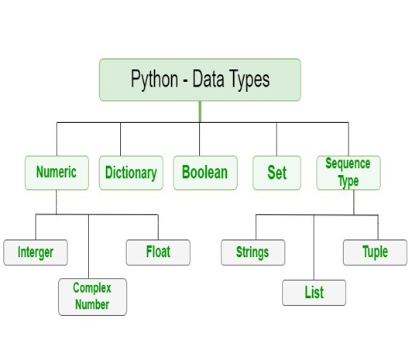
DATA TYPES IN PYTHON
Variables can store data of different types, and different types can do different things.
Python has the following data types built in by default.
The data type is set when you assign a value to a variable
To verify the type of any object in Python, use the type() function.
Data Type with one of the two built-in values , True or False.

Slide 19
PYTHON NUMBERS
There are three numeric types in Python:
int
float
complex
Variables of numeric types are created when you assign a value to them:
x = 1 # int
y = 2.8 # float
z = 1j # complex
To verify the type of any object in Python, use the type() function: print(type(x))
print(type(y))
print(type(z))

Slide 20
Float
Float, or "floating point number" is a number, positive or negative, containing one or more decimals.
x = 1.10
y = 1.0
z = -35.59
print(type(x))
print(type(y))
print(type(z))

Slide 21
PYTHON CASTING
Casting in python Can be done by using the following functions
int() - constructs an integer number from an integer literal, a float literal (by removing all decimals), or a string literal (providing the string represents a whole number)
float() - constructs a float number from an integer literal, a float literal or a string literal (providing the string represents a float or an integer)
str() - constructs a string from a wide variety of data types, including strings, integer literals and float literals
example
x = int(1) # x will be 1
y = int(2.8) # y will be 2
z = int("3") # z will be 3

Slide 22
x = float(1) # x will be 1.0
y = float(2.8) # y will be 2.8
z = float("3") # z will be 3.0
w = float("4.2") # w will be 4.2
x = str("s1") # x will be 's1'
y = str(2) # y will be '2'
z = str(3.0) # z will be '3.0'

Slide 23
PYTHON STRINGS
Strings in python are surrounded by either single quotation marks, or double quotation marks.
'hello' is the same as "hello".
You can display a string literal with the print() function:
print("Hello")
print('Hello')
Assign String to a Variable
a = "Hello"
print(a)

Slide 24
Multiline Strings
You can assign a multiline string to a variable by using three quotes Or three single quotes:
a = "“” Strings in python are surrounded by either
single quotation marks, or
double quotation marks.."""
print(a)

Slide 25
SLICING STRINGS
Specify the start index and the end index, separated by a colon, to return a part of the string.
Get the characters from position 2 to position 5 (not included):
b = ”KLH BOWREMPET"
print(b[2:5])
o/p H B
Slice From the Start
By leaving out the start index, the range will start at the first character:
b = ”KLH BOWREMPET"
print(b[:8])
o/pKLH BOWR
Slice To the End
By leaving out the end index
b = ” KLH BOWREMPET“
print(b[5:])
o/p: WREMPET

Slide 26
Negative Indexing
Use negative indexes to start the slice from the end of the string:
b =" KONERU LAKSHMAIAHA EDUCATIONAL FOUNDATION "
print(b[-10:-4])
o/p:
String Methods
Method Description
capitalize() Converts the first character to upper case
casefold() Converts string into lower case
center() Returns a centered string
count() Returns the number of times a specified value occurs in a string

Slide 27
find() Searches the string for a specified value and returns the position of where it was found
index() Searches the string for a specified value and returns the position of where it was found
islower() Returns True if all characters in the string are lower case
isupper() Returns True if all characters in the string are upper case
join() Joins the elements of an iterable to the end of the stringl
lower() Converts a string into lower case
replace() Returns a string where a specified value is replaced with a specified
swapcase() Swaps cases, lower case becomes upper case and vice versa
title() Converts the first character of each word to upper case
upper() Converts a string into upper case
zfill() Fills the string with a specified number of 0 values at the beginning

Slide 28
A=" KONERU LAKSHMAIAHA EDUCATIONAL FOUNDATION "
print(A.lower())
print(A.find('I'))
print(A.capitalize())
print(A.swapcase())
Print(A.title())
Print(len(A))
o/p: koneru lakshmaiaha educational foundation
5
koneru lakshmaiaha educational foundation
koneru lakshmaiaha educational foundation
koneru lakshmaiaha educational foundation
55

Slide 29
SLICING STRING CONCATENATION
FOR CONCATENATING 2 STRINGS WE HAVE TO USE + SYMBOL
a = ”klh"
b = “BOWREMPET"
c = a + b
print(c)
c=a+” “ +b

Slide 30
STRING FORMAT() METHOD
The format() method formats the specified value and insert them inside the string’s place holder. The placeholder is defined using curly brackets:{}
Syntax:
string.format(value1, value2...)
txt1 = "My name is {fname}, I'm {age}".format(fname = "John", age = 36)
txt2 = "My name is {0}, I'm {1}".format("John",36)
txt3 = "My name is {}, I'm {}".format("John",36)
:< Left aligns the result (within the available space)
:> Right aligns the result (within the available space)
:^ Center aligns the result (within the available space)
:= Places the sign to the left most position
:+ Use a plus sign to indicate if the result is positive or negative
:- Use a minus sign for negative values only
:f Fix point number format

Slide 31
PYTHON OPERATORS
Arithmetic operators : ( +,-,*,/, %, **, //)
Assignment operators : (+,+=,-= ………….)
Comparison operators : (==,!=,>=,<=, <,>)
Logical operators : (and, or,not)
Identity operators : (is, is not)
Membership operators : (in, not in)
Bitwise operators : (and &,or |,xor ^,not ~)

Slide 32
CONDITIONAL STATEMENTS
Conditional Statements:
An "if statement" is written by using the if keyword.
Syntax : if condition :
true statements
Ex: a = 33
b = 200
if b > a:
print("b is greater than a")

Slide 33
We can also use else with if condition.
Syntax : if condition :
true statements
else:
False statements
a = 200, b = 33
if b > a:
print("b is greater than a")
else:
print("b is not greater than a")

Slide 34
The elif keyword is pythons way of saying "if the previous conditions were not true, then try this condition".
Syntax : if condition :
true statements
elif condition :
true statements
else :
false statements
if b > a: #a=33 ,b=33
print("b is greater than a")
elif a == b:
print("a and b are equal")

Slide 35
Write a program to check whether the given number is even or not
Write a program to find the biggest of 3 numbers.
Write a program to find the grade of a student by inputting 3 subjects marks.

Slide 36
FOR LOOP
A for loop is used for iterating over a sequence (that is either a list, a tuple, a dictionary, a set, or a string).
This is less like the for keyword in other programming languages and works more like an iterator method as found in other object-orientated programming languages.
With the for loop, we can execute a set of statements, once for each item in a list, tuple, set, etc.
fruits = ["apple", "banana", "cherry"]
for x in fruits:
print(x)
range() Function:
The range() function returns a sequence of numbers, starting from 0 by default, increments by 1 (by default), and ends at a specified number.
for x in range(6):
print(x)
for x in range(2, 30, 3): #start value, end value, increment by value
print(x)
To print the numbers in the reverse order
For x in range(50,5,-5)
Pritnt(x)

Slide 37
Write a program to print the even numbers from 1 to 100
Write a program to check whether the given number is palindrome or not.
Write a program to check whether the given number is prime not.

Slide 38
WHILE LOOP
With the while loop we can execute a set of statements as long as a condition is true.
i = 1
while i < 6:
print(i)
i += 1
With the break statement, we can stop the loop even if the while condition is true.
i = 1
while i < 6:
print(i)
if i == 3:
break
i += 1

Slide 39
With the continue statement we can stop the current iteration, and continue with the next
i = 0
while i < 6:
i += 1
if i == 3: continue print(i)

Slide 40
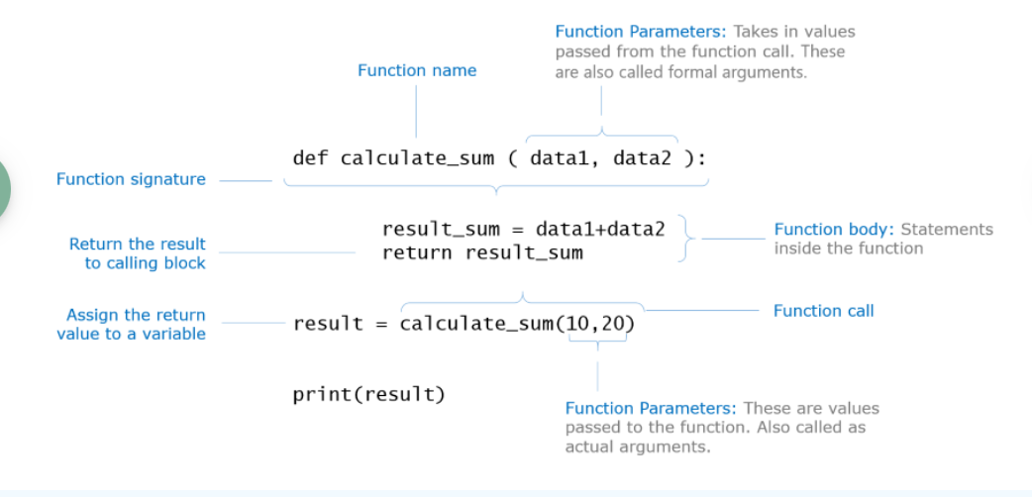
FUNCTIONS IN PYTHON

Slide 41
def find_square(n):
return n * n
numb_to_square = input()
square = find_square(int(numb_to_square))
print(f"The square of {numb_to_square} is {square}")

Slide 42
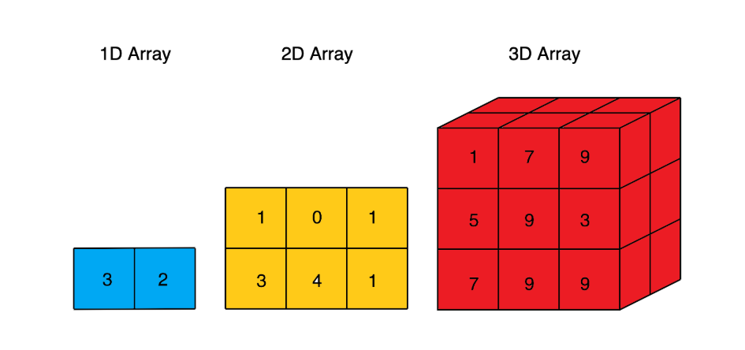
NUMPY
Numeric-Python (Numpy), is a Python library that is used for numeric and scientific operations. It serves as a building block for many libraries available in Python.
Data structures in Numpy
The main data structure of NumPy is the ndarray or n-dimensional array.
The ndarray is a multidimensional container of elements of the same type as depicted below. It can easily deal with matrix and vector operations.

Slide 43
Following are the benefits of using Numpy:
As the array size increases, Numpy can execute more parallel operations, thereby making computation faster.
NumPy has many optimized built-in mathematical functions.
Another great feature of NumPy is that it has multidimensional array data structures that can represent vectors and matrices.
Numpy allows you to perform the following operations on Arrays
An array is a special variable, which can hold more than one value at a time.
Arrays are used to store multiple values in one single variable
An array can hold many values under a single name, and you can access the values by referring to an index number
Arrays Slicing
Array Join
Array Split
Array Reshaping
Array Filter

Slide 44
Importing Numpy
Numpy library needs to be imported in the environment before it can be used as shown below. 'np' is the standard alias used for Numpy.
import numpy as np
Numpy object creation
Arrays can be crested by passing tuples and lsits
Numpy array can be created by using array() function. The array() function in Numpy returns an array object named ndarray.
Syntax: var= np.array(object)
object – A python object(for example, a tuple or list)

Slide 45
Import numpy as np
N=np.array([10,12,13,14])
Print(type(N))
By passing lists
N=np.array([1,2,3])
Dimensions in Arrays:
0 dimension
1 or 2 Dimension
We have to use ndarray.ndim attribute
n=np.array(23)
Print(n.ndim)
o/p:= 0

Slide 46
N=np.array([1,2,3,4,5,6])
Print(N)
P=np.array([1,2,3],[4,5,6])
Print(p)
Print(N.ndim)
Initialize numpy arrays
P=np.zeros([1])
N=np.zeros([3,4])
Print(N)
Print(type(N)
o/p dimensions 0 [[0. 0. 0. 0.] [0. 0. 0. 0.] [0. 0. 0. 0.]]
<class 'numpy.ndarray’>
P=np.ones([1])
N=np.ones([3,4])
Print(N)
Print(type(N)

Slide 47
Array Indexing
We can slice 1D ,2D array
Import numpy as np
P=np.array([12,23,34,45,56,67,78])
Print(p[0])
Print(p[5])
Q=np.array([1,2,3],[6,7,8])
Print Q[0,0] 1 dim1 element 1 1 q[1,0] 6
Q[0,1] 2 q[1,1] 7
Q[0,2] 3 q[1,2] 8
S=np.array([[[1,2,3],[4,5,6],[[6,7,8],[9,7,8]]]])
S[0,0,1]
S[0,0,2]

Slide 48
Negative indexing:
P=np.array([1,2,3,4,5])
Print(P[-1])
P=np.array([[1,2,3],[4,5,6]])
Print(P[-1,-1]) #prints 3
Array slicing
Print(p[2:5] #it includes element at index 2 but excludes element at 5
Print(p[:5]) # from first element upto 4th index
Print(p[4:]) #starting from 4th index to last index
We can also include step
Array([start:end:step])

Slide 49
Slicing 2D array
N=np.array([1,2,3,4,5],[6,7,8,9,0])
Print(N[0,2:4])
p=np.array([[1,2,3,4,5,6],[6,7,8,9,3,2]])
print(p[0:2,2:5])
o/p : [[3 4 5] [8 9 3]]
Numpy array shape The number of elements in each dimension of an array is called the shape.
#gives the number of elements
N=np.array([1,2,3,4,5])
Print(n)
Print(n.ndim) #0
Print(n.shape) #5
p=np.array([[1,2,3,4,5,6],[6,7,8,9,3,2]])
Print(p.shape) #(2,6)

Slide 50
Array Reshape:
The reshape the number of dimensions,we use the numpy.reshape() method in python.
Reshape allows us to edit the number of elements in a dimension.with reshape we can add or remove dimensions.
Reshape from 1D to 2D
n=np.array([1,2,3,4,5,6])
print(n.shape) #(6,)
print(n.reshape(2,3)) #[[1 2 3] [4 5 6]]
print(n.reshape(3,2)) #[[1 2] [3 4] [5 6]]
Reshape from 3D array to 1D array
N.reshape(-1)

Slide 51
Looping 1DArray Elements:
import numpy as np
n=np.array([1,2,3,4,5,6])
for x in n:
print(x)
Looping 2D array
p=np.array([[1,2,3],[4,5,6],[7,8,9]])
for a in p:
print(a)

Slide 52
Joining arrays: it is possible to join 2 arrays into a single new array
Concatenate()
import numpy as np
n1=np.array([1,2,3,4])
n2=np.array([4,5,6,7,])
n3=np.concatenate((n1,n2))
print(n3) o/p: [1 2 3 4 4 5 6 7]
Split numpy array: array_split(arrname,number)
n1=np.array([1,2,3,4])
n2=np.array([4,5,6,7,])
n3=np.concatenate((n1,n2))
print(np.array_split(n3,4))
o/p : [array([1, 2]), array([3, 4]), array([4, 5]), array([6, 7])]

Slide 53
Aceesing individual arrays after splitting
n1=np.array([1,2,3,4])
n2=np.array([4,5,6,7,])
n3=np.concatenate((n1,n2))
sp=np.array_split(n3,4)
print(sp[0]) # [1 2]
import numpy as np
n1=np.array([[1,2,3],[4,5,6]])
x=np.array_split(n1,2)
print(x)
print(x[0])
print(x[1])

Slide 54
Searching in an array : we can search for an element in an array using where() method.
import numpy as np
n1=np.array([4,2,3,4])
p=np.where(n1==4)
print(p)
Sorting array: we have to use sort() method.
n1=np.array([4,2,3,1])
p=np.sort(n1)
print(p)
import numpy as np #sorting string array
n=np.array(['hi','java','pyth','app'])
print(np.sort(n))

Slide 55
Arithmetic operations on arrays
Sum(): adding all elemets in the array
n1=np.array([1,2,3,4])
n2=np.array([4,5,6,7,])
print(np.sum([n1,n2]))
o/p : 32
n1=np.array([1,2,3,4])
n2=np.array([4,5,6,7,])
print(np.sum([n1,n2],axis=1)) adds row wise elements : 10, 22
n1=np.array([1,2,3,4])
n2=np.array([4,5,6,7,])
print(np.sum([n1,n2],axis=0)) adds colums wise

Slide 56
print(np.subtract(n1,n2))
print(np.multiply(n1,n2))
print(np.divide(n1,n2))

Slide 57

THANK YOU
Team – DS

